Slide 1
BUSINESS INTELLIGENCE CASE STUDY
:: INTERNAL AUDIT

Slide 2
INTERNAL AUDIT :
Internal Audit is an independent, objective, assurance to add value to and improves an organization’s operations.
It is disciplined approach to evaluate and improve the effectiveness of Risk Management , Control and governance processes.

Slide 3
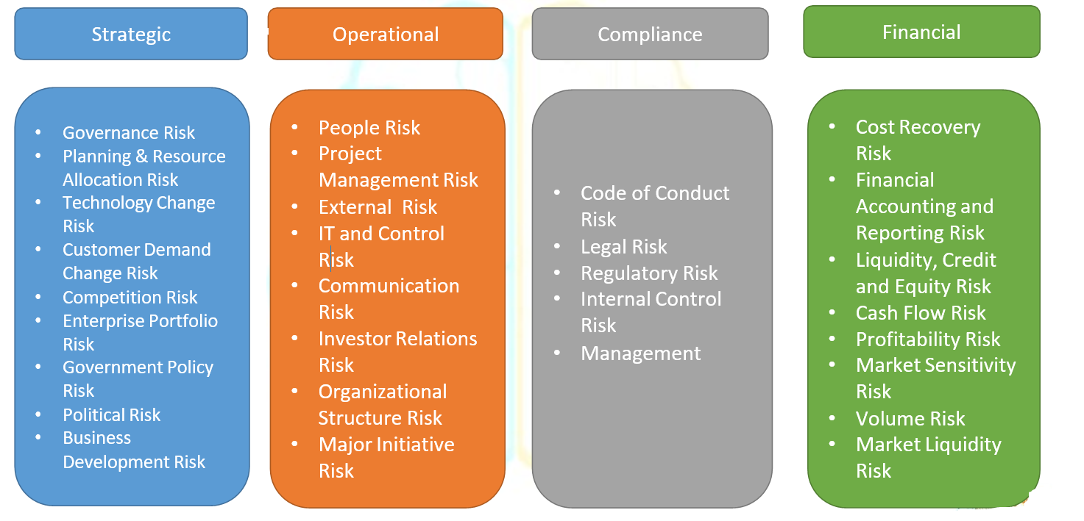
INTERNAL AUDIT MITIGATE THE RISK

Slide 4
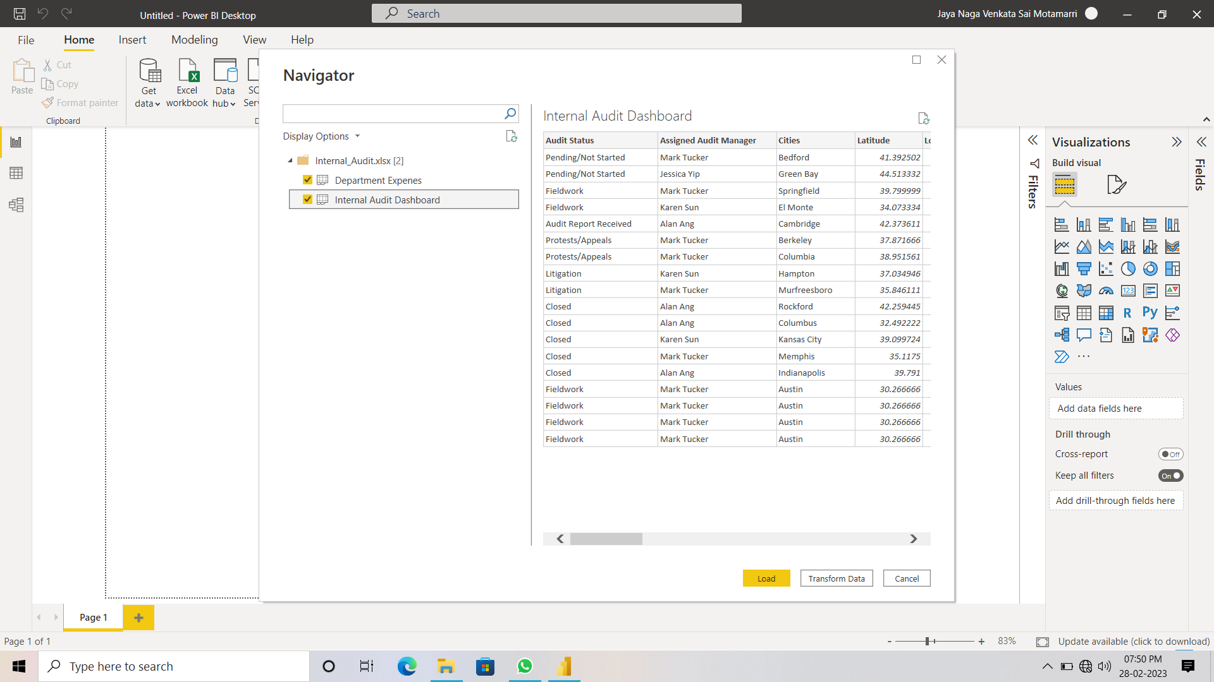
DATSET PREVIEW & LOAD

Slide 5
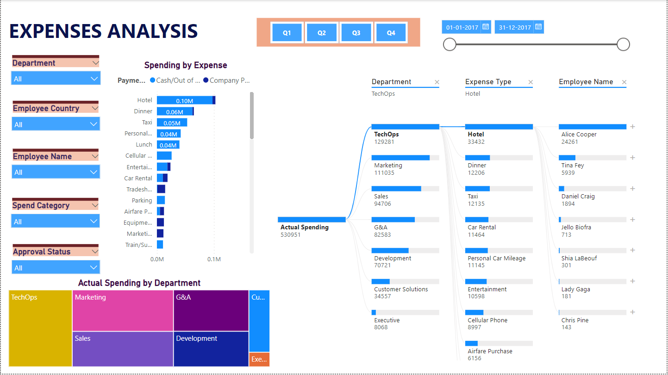

Slide 6
